Slide 1
Cancelation Factors and Resources Efficiency in Hotels

Slide 2
Problems
One in four hotel guests are canceling their booking ahead of a stay - an increase being driven by the sales tactics of online travel agencies.
The trend is causing problems for hoteliers who are unable to accurately forecast occupancy within their revenue management departments and creates headaches when organizing distribution across various channels.
source : https://www.phocuswire.com/Hotel-distribution-market-share-distribution-analysis#:~:text=The%20average%20cancelation%20rate%20in,of%206.4%25%20over%20four%20years.
1
2
Resource management in the hotel is one of the strategies that should be focused on. Imagine if a restaurant’s team has expired groceries. Imagine if many workers like waiters or waitresses have much their own idle time.
We, as a management level of the hotel, do not want these inefficient resources as we could lose our money and increase many costs, especially on humans and food.
Masukkan teks Anda di sini Masukkan teks Anda di sini Masukkan teks Anda di sini Masukkan teks Andadi sini Masukkan teks Anda di sini Masukkan teks Anda di sini Masukkan teks Anda di sini.
Masukkan teks Anda di sini Masukkan teks Anda di sini Masukkan teks Anda di sini Masukkan teks Anda di sini Masukkan teks Anda di sini Masukkan teks Anda di sini Masukkan teks Anda di sini.
4
3

Slide 3
project Goals
1. Find out what lead into high cancellation rate for hotels
2. Maximize resources within hotels
Notes:
Finding out what are the variables that lead into a high cancellation rate within hotels
Helping Hotels to decide when to stock more supplies and hire more part time worker during busy season and when to reduce stock hire less part time worker (Resources)

Slide 4
Understanding the Market

Slide 5
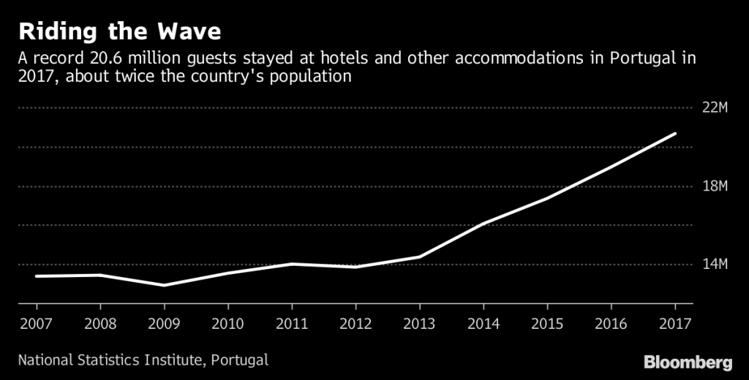
Hospitality Trends
TIPS CEPAT
Cobalah mengklik kanan pada foto dan gunakan "Ganti Foto" untuk menampilkan foto Anda sendiri.
Masukkan teks Anda di sini Masukkan teks Anda di sini Masukkan teks Anda di sini Masukkan teks Anda di sini. Masukkan teks Anda di sini Masukkan teks Anda di sini.
Implikasi Klien:
Masukkan teks Anda di sini Masukkan teks Anda di sini Masukkan teks Anda di sini Masukkan teks Anda di sini Masukkan teks Anda di sini Masukkan teks Anda di sini Masukkan teks Anda di sini Masukkan teks Anda di sini.
Notes:
Portugal Hospitality industry has been on the uptrend since 2007 and having an exponential growth, recording a 20.6 million of hotel guest in 2017

Slide 6
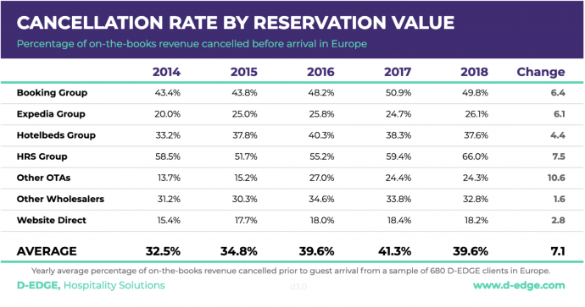
Cancellation Trend

Slide 7
Analysis

Slide 8
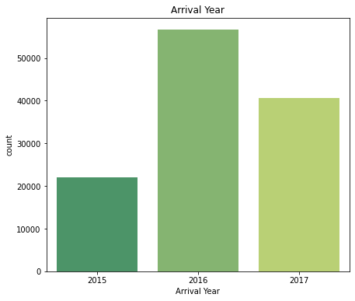
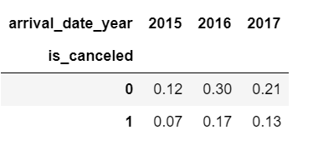
Arrival Year by Year Analysis
Notes:
Note : Dataset from 2015 & 2017 doesn’t represent the entire year since both data set either start at the middle of the year or the data set end at the middle of the year
Only dataset of 2016 that represent an entire year

Slide 9
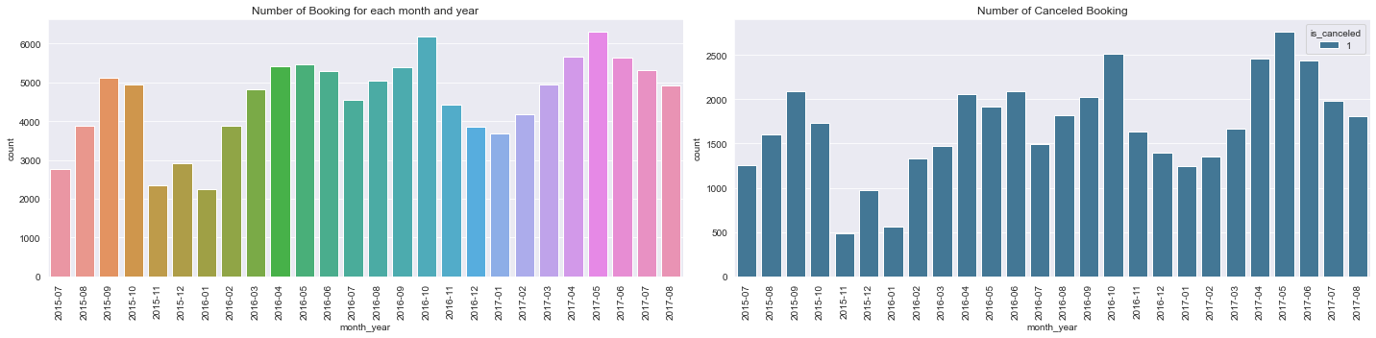
Number of Booking & Number of Cancellation
Number Booking has a positive correlation with Number of Cancellation
Highest number of booking and highest number of cancellation is recorded in the same month

Slide 10
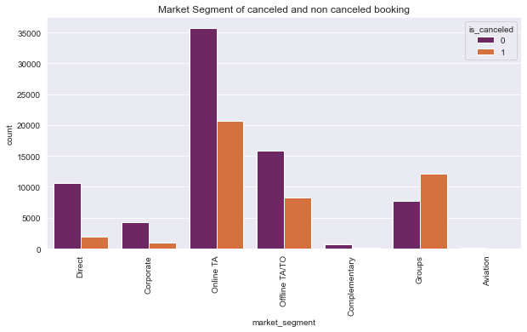
Market Segment & Cancellation
Online travel agent has the highest confirmed booking and the highest number of canceled booking
Group Market segment has higher number of cancellation compared to it’s confirmed

Slide 11
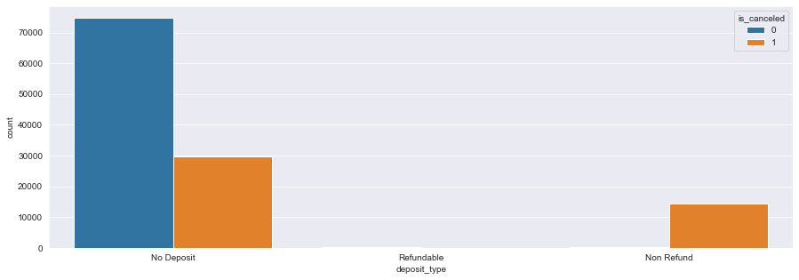
Deposit Type & Cancellation
Most confirmed booking has a no deposit type policy
Highest Cancellation also has a no deposit policy
No deposit Policy might be reason why a there’s a high rate of cancellation

Slide 12
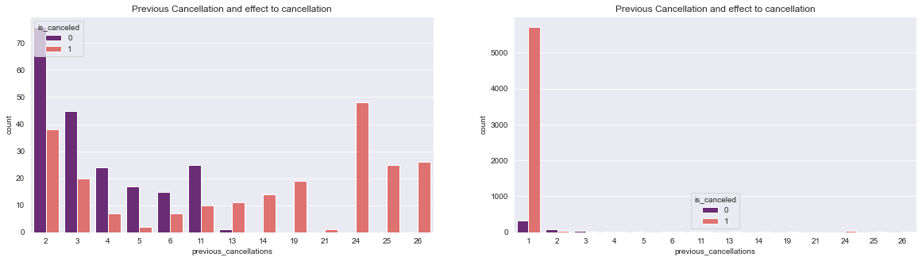
Previous Cancellation & Cancellation
- For Traveler who has cancelled before, traveler that cancelled 1 time seems to have the highest tendencies to cancel again
- For Traveler that has cancelled more than 11 times their cancellation rate is way higher compared to it’s confirmed booking

Slide 13
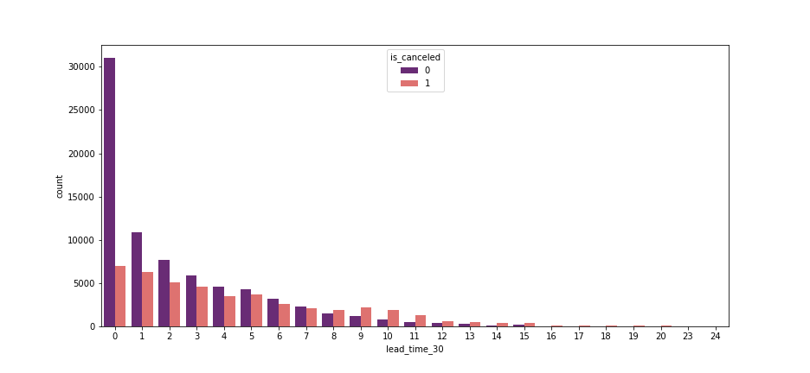
Lead Time & Cancellation
Customers who has more than 210 days lead time has a higher cancellation rate compared to it’s confirmed booking
*lead time = arrival date - booking date

Slide 14
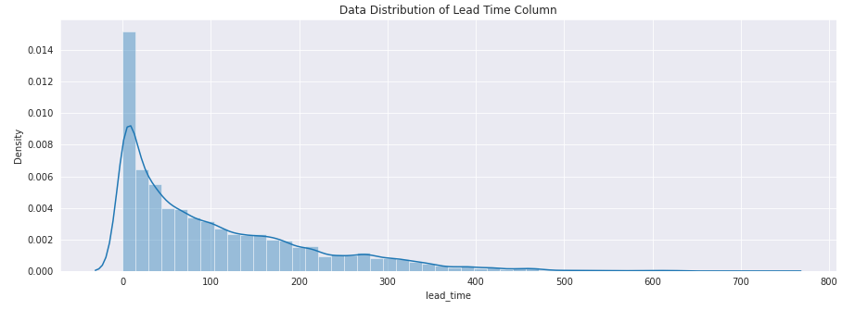
‘Lead Time’ Data Distribution
Data Distribution of Lead Time is shown as Right-skewed distribution.

Slide 15
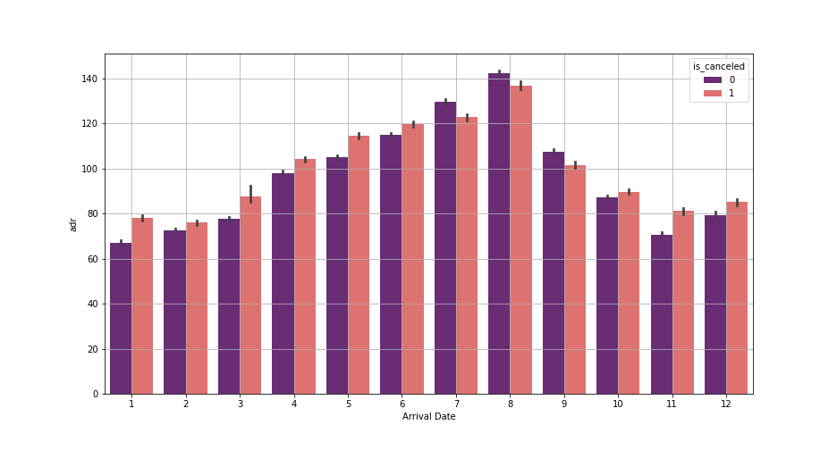
Average Daily Rate & Cancellation
Highly ADR for cancellation occured all of months except for July, August and September

Slide 16
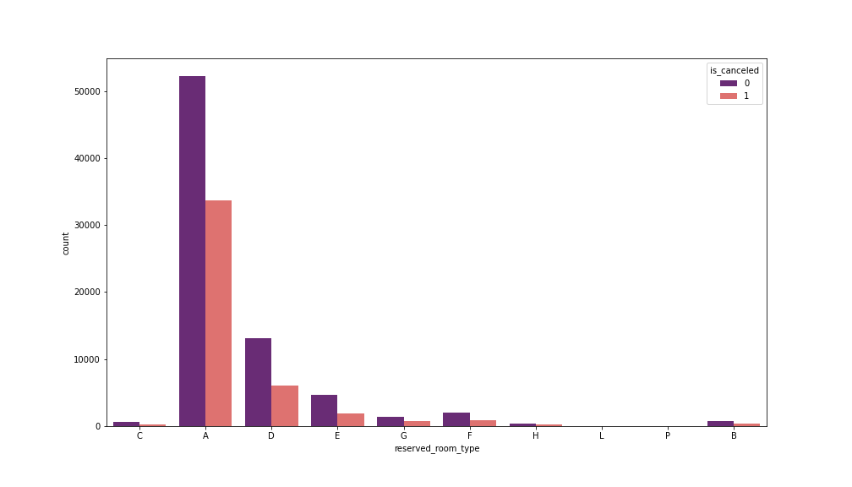
Reserve Room & Cancellation
Room type A has high number of reserved but also have high cancellation compare to others room type

Slide 17
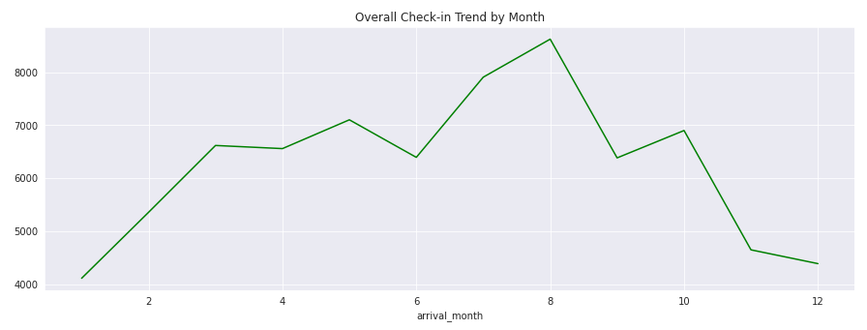
Overall Check-in Trend by Month
Most guests come and start to stay in August, July, May, and October.

Slide 18
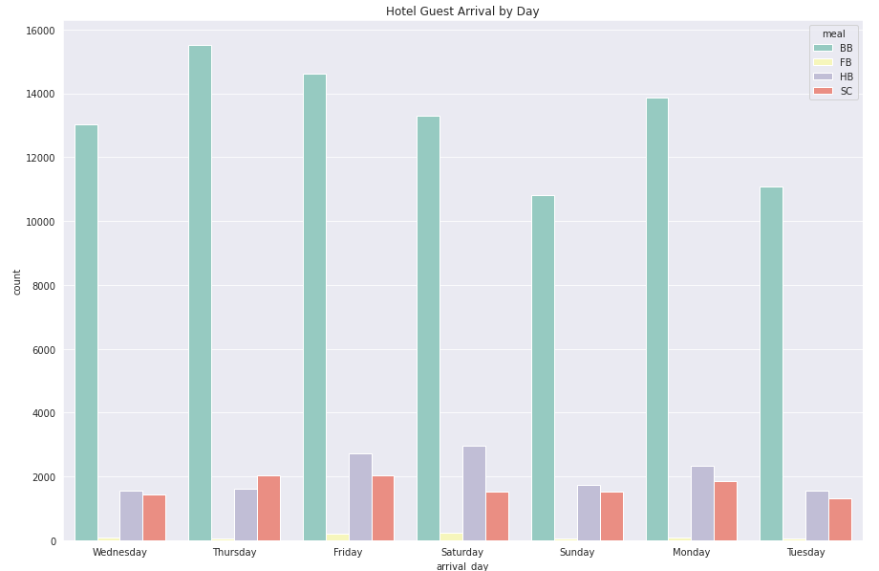
Hotel Guest
Arrival
By Day
Most guests choose Bed-Breakfast (BB) while staying in the hotel.

Slide 19
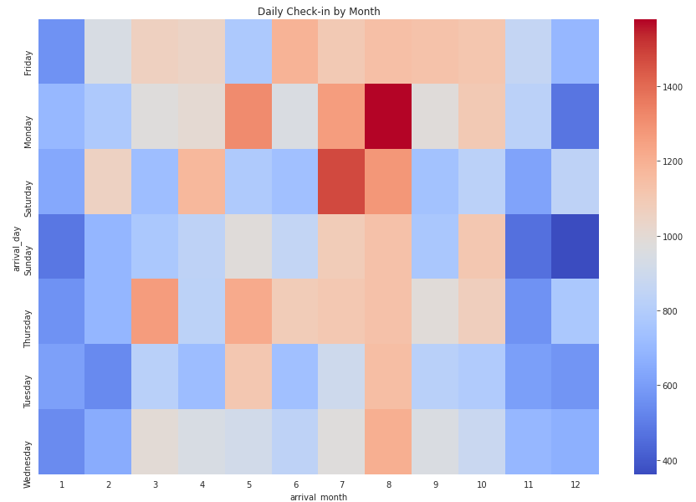
Daily Check-in
by Month
Daily Check-in shows us about how crowded hotels on what month and on what day.

Slide 20
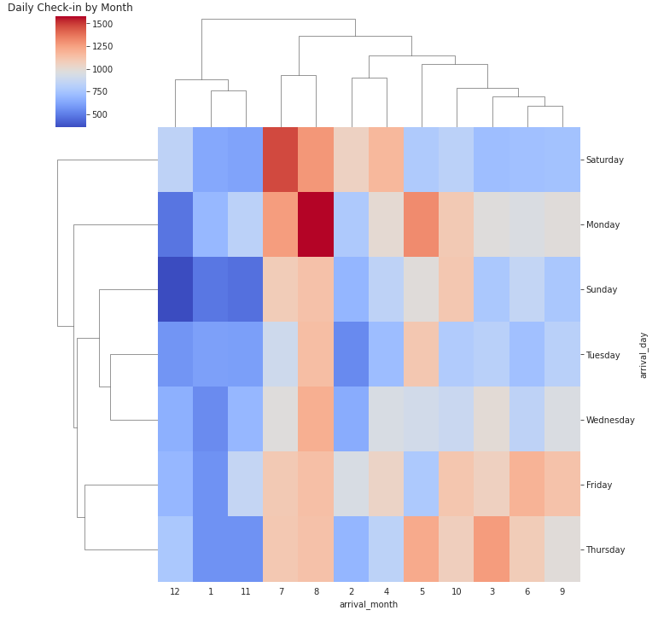
Daily Check-in by Month
Cluster map differs contrast about how crowded hotels on what day and on what month.

Slide 21
Summary
Number Booking have a positive correlation with the number of cancellation.
Group Booking is the only market segment that have a higher cancellation arrival compared to it’s confirmed arrival.
Customer who has 7 month or more lead time have a higher tendencies to cancel their booking.
Traveler that has cancelled 1 time before has the highest tendencies to cancel again.
Guests tend to book their rooms with breakfast instead of lunch or dinner.
Most guests come and start to stay in May, July, August, and October.
In Portugal, the busiest month in the hotels are July and August, especially on Saturday and Monday when guests start to check-in.

Slide 22
Recommendations
More Rigid /Stricter Cancellation T&C For Customer Who has Cancelled Before
Non Refundable Only for Group Booking
Non Refundable Booking Only For Booking with More than 210 lead days
Breakfast Awareness
Resources Efficiency
This is one way to reducing the tendencies of customers who have cancelled before to cancelled again
Group Booking has a higher cancellation rate compared to the confirmed rate, with this policy hotel would not suffer any loss revenue caused by cancelled group booking
Since Customer who has more than 210 lead days has a higher chance of cancellation, having this policy will protect the hotel from losing revenue
Guests tend to have their bedrooms with breakfast package, so it might be good if management place more workers in the morning instead of noon or night. Even workers at the noon can be reduced and moved into the night shift.
Resources are precious, especially when it comes to food and humans. July and August are the best time to stock more food especially on Saturday and Monday where guests start to check-in the room. The restaurant team could increase the number of workers too, to handle guests when meal time has come.
This is good for cost efficiency so the resources either humans or food might not be wasted.

Slide 23
Thank you

